Slide 1
OBJETIVOS
Students will identify the countries and nationalities after viewing/listening to a video
Say which country they are from after viewing a power-point.
Interview their classmates to find out which country he/he is from after observing an example of the structure from the teacher.
State their nationality as well as the nationality of someone.

Slide 2
Spanish-speaking Countries and Nationalities
Notes:
‹#›

Slide 3
Sudamerica

Slide 4
La América del Sur
Venezuela
Colombia
Ecuador
Perú
Bolivia
Paraguay
Chile
Uruguay
La Argentina

Slide 5
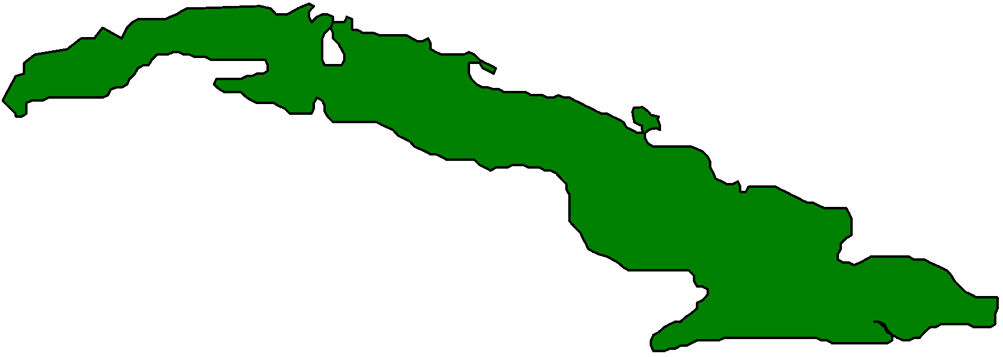


Las Antillas
Puerto
Rico
Cuba
La República
Dominicana
España

Slide 6


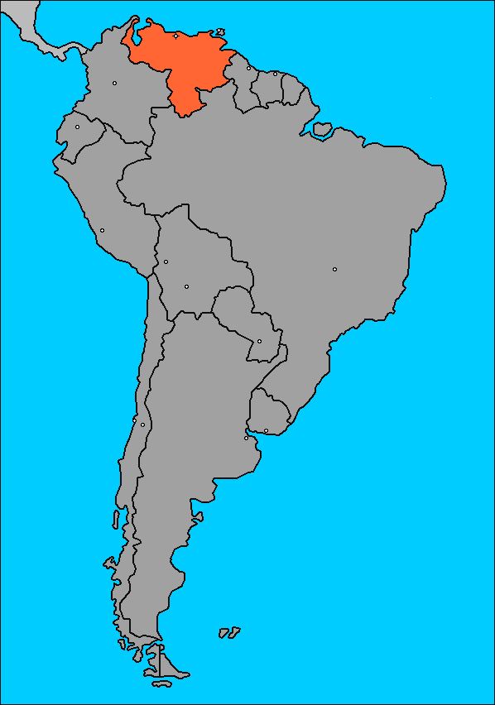
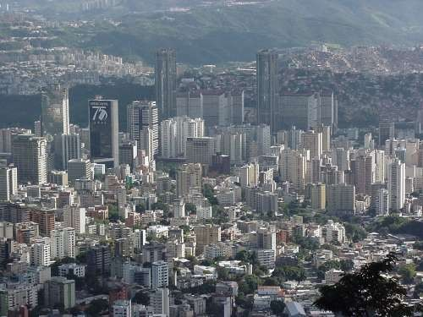
Venezuela
Capital: Caracas
Nationality: venezolano/venezolana
Notes:
‹#›

Slide 7

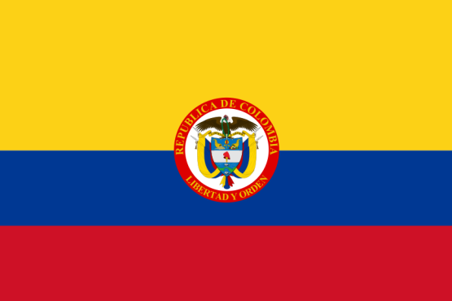
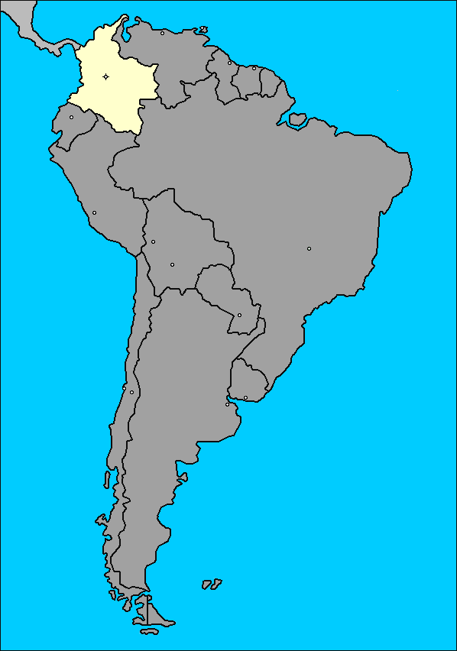
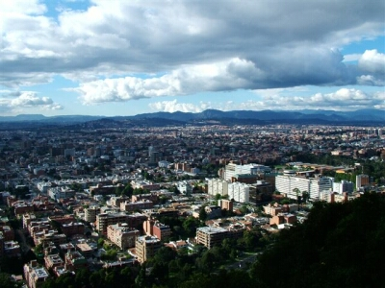
Colombia
Capital: Bogotá
Nationality:
colombiano/colombiana

Slide 8

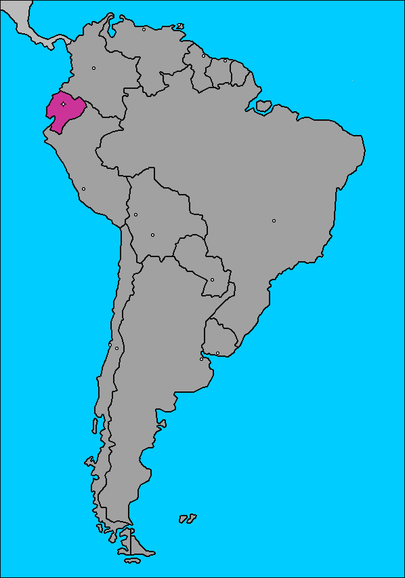
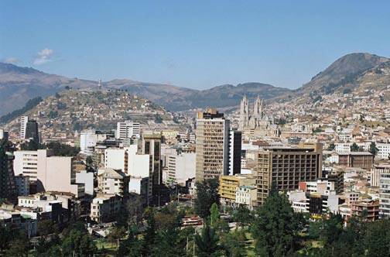
Ecuador
Capital: Quito
Nacionalidad:
ecuatoriano/ecuatoriana

Slide 9

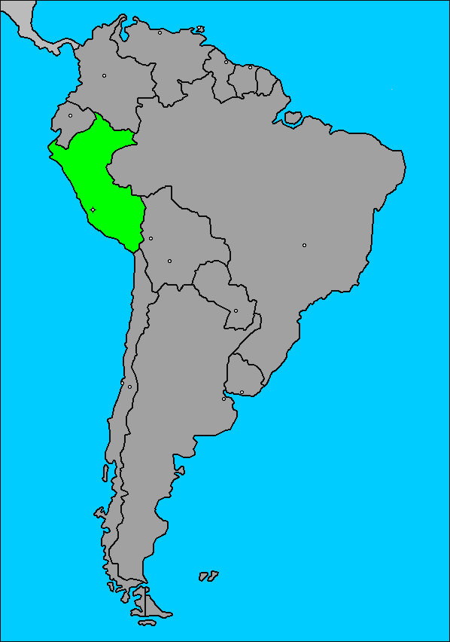
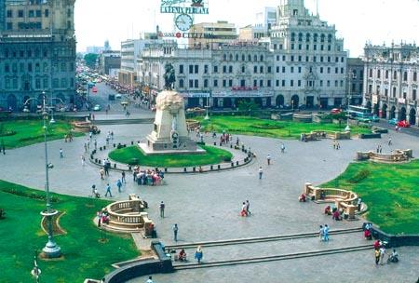
Perú
Capital: Lima
Nationality: peruano/peruana

Slide 10

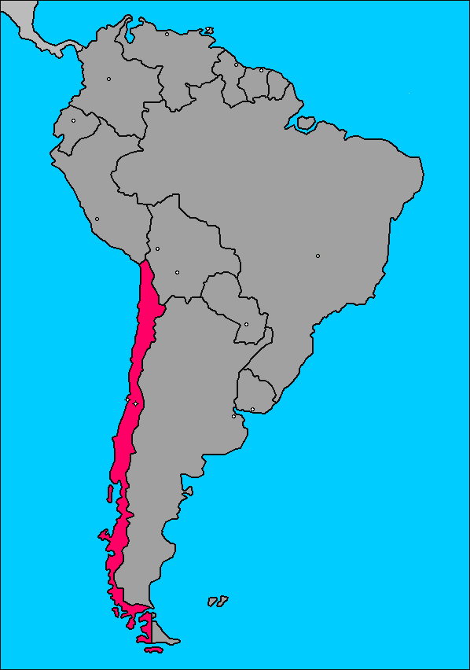
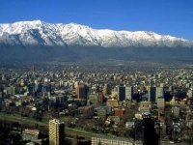
Chile
Capital: Santiago
Nationality: chileno/chilena

Slide 11
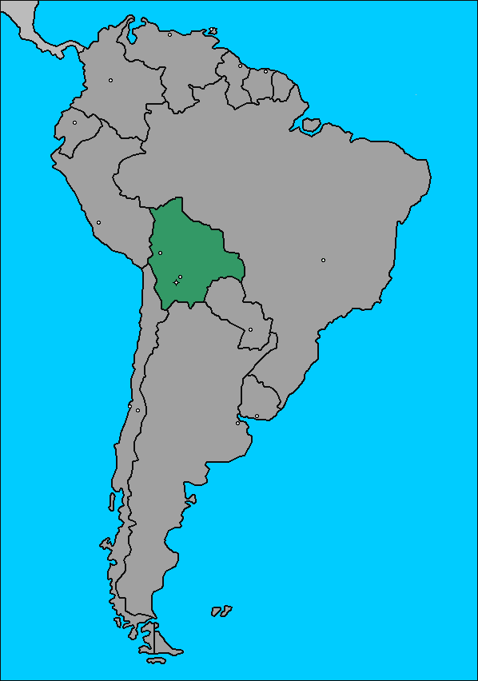

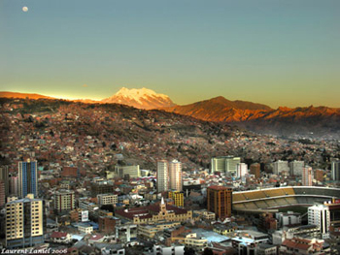
Bolivia
Capital: La Paz, Sucre
Nationality:
boliviano / boliviana

Slide 12

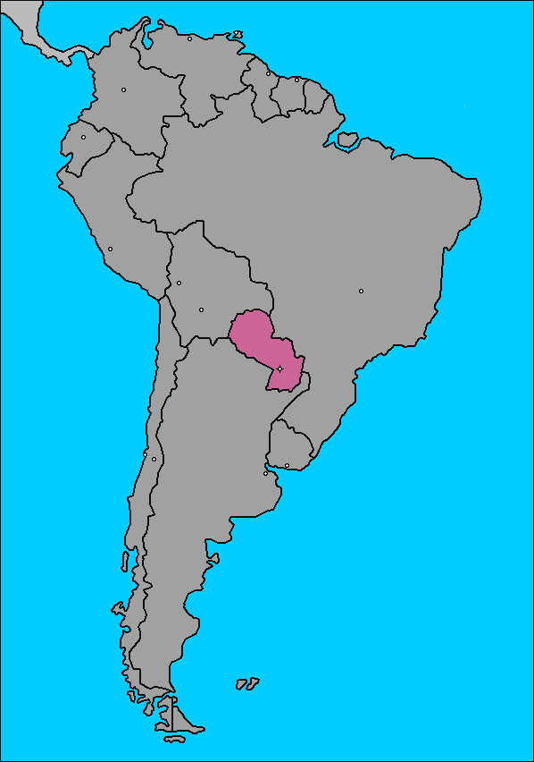
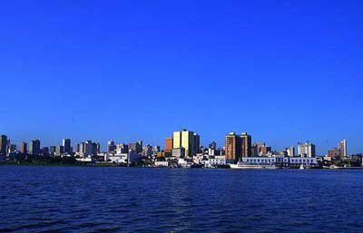
Paraguay
Capital: Asunción
Nationality: paraguayo/paraguaya

Slide 13

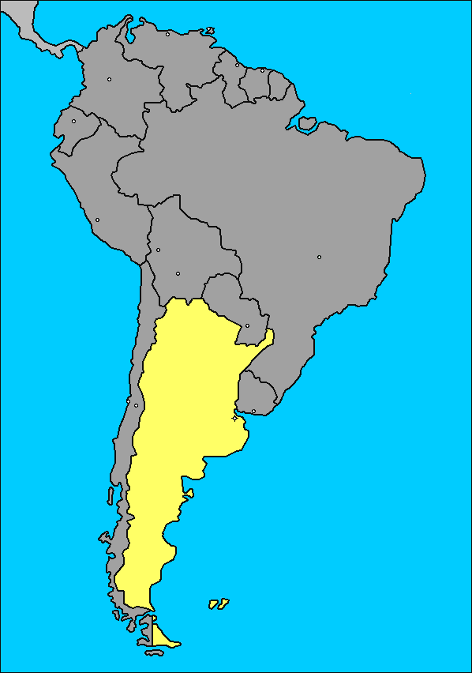
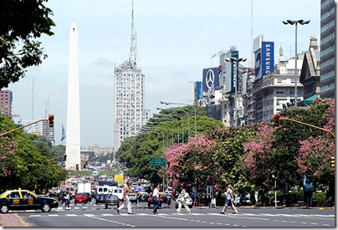
Argentina
Capital: Buenos Aires
Nationality: argentino/argentina

Slide 14

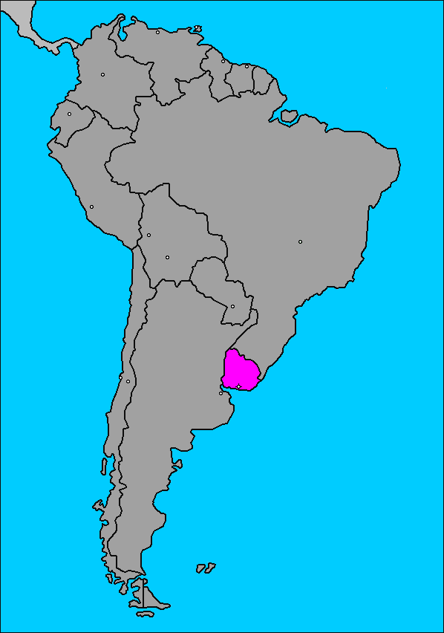
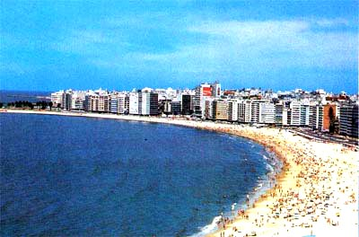
Uruguay
Capital: Montevideo
Nationality:
uruguayo/uruguaya

Slide 15
Central America, Mexico and the Caribbean
América Central, el Caribeño y México

Slide 16
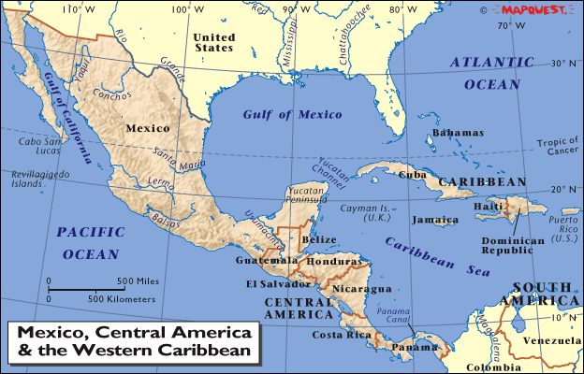

Slide 17
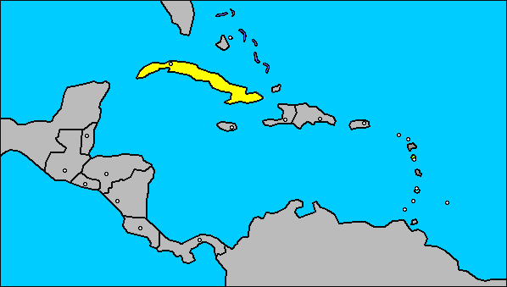

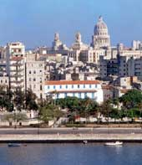
Cuba
Capital: La Habana
Nacionalidad:
cubano/cubana
Notes:
‹#›

Slide 18

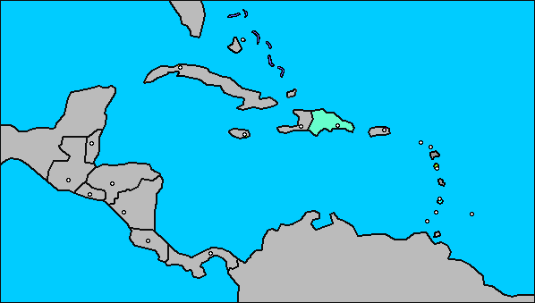
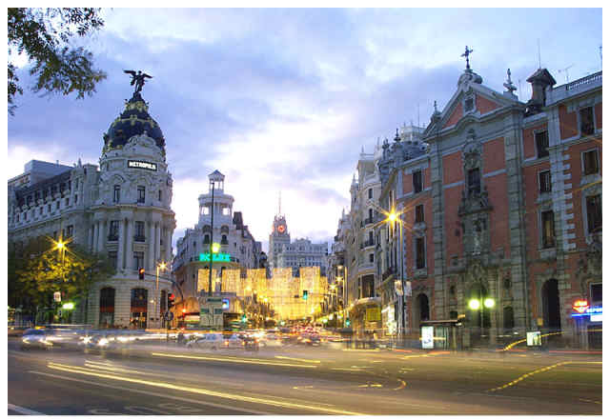
Republica Dominicana
Capital: Santo Domingo
Nationality: dominicano/dominicana

Slide 19
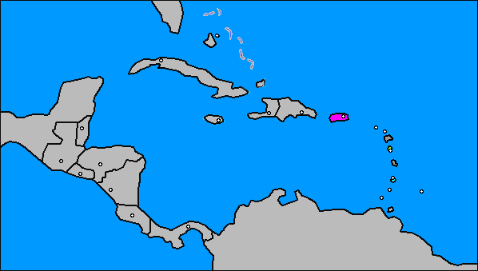

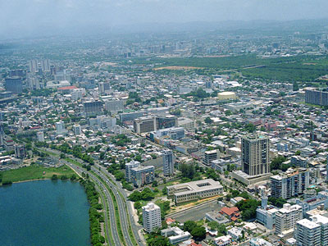
Puerto Rico
Capital: San Juan
Nationality: puertorriqueño/puertorriqueña

Slide 20
México y la América Central
Honduras
México
Nicaragua
Guatemala
El Salvador
Costa Rica
Panamá

Slide 21

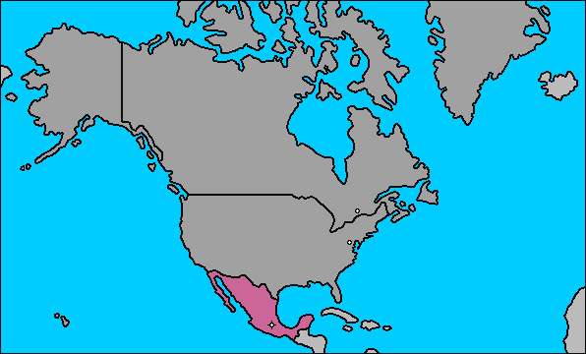
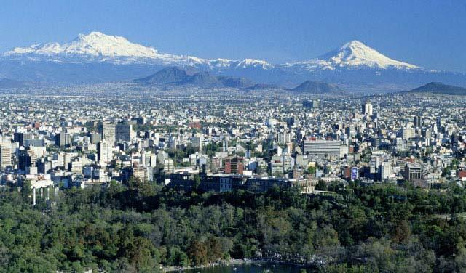
Capital:
Ciudad de México, DF (distrito federal)
México
Nacionalidad: mexicano/mexicana

Slide 22
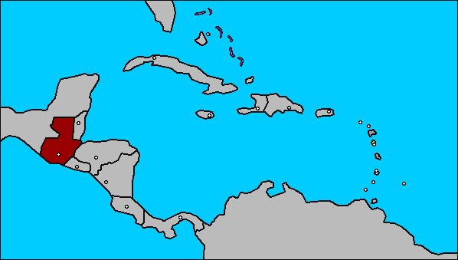

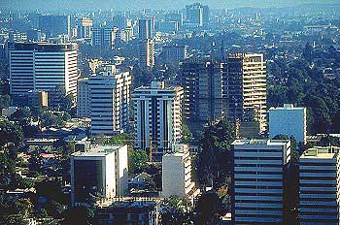
Guatemala
Capital: Ciudad de Guatemala
Nationality: guatemalteco/guatemalteca

Slide 23
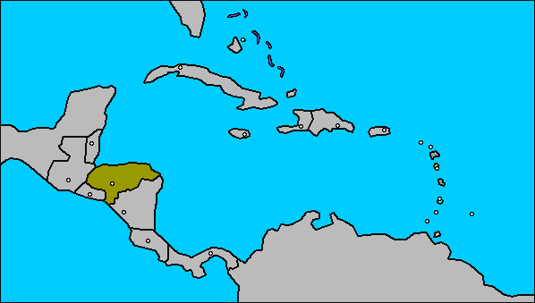

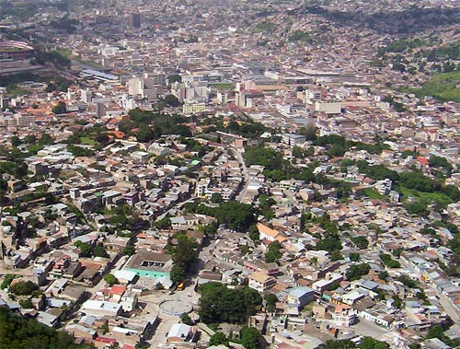
Honduras
Capital: Tegucigalpa
Nacionalidad:
hondureño/hondureña

Slide 24
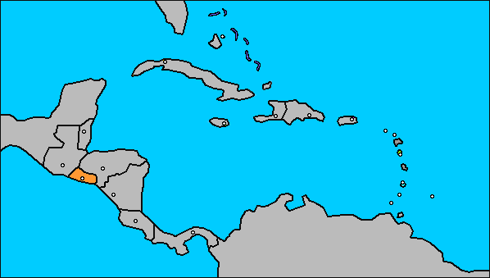

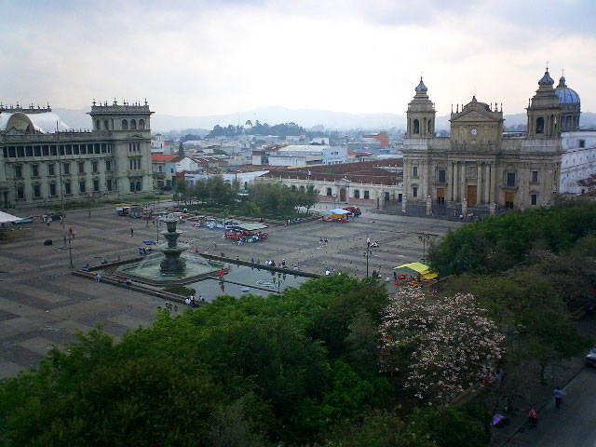
El Salvador
Capital:
San Salvador
salvadoreño/salvadoreña

Slide 25
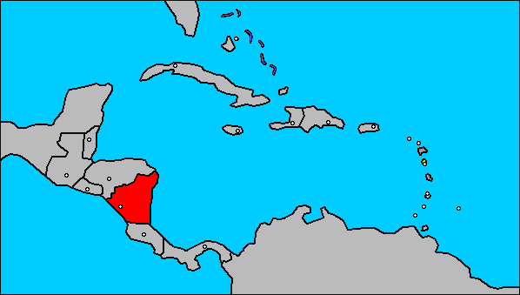

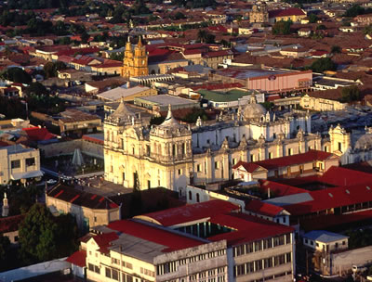
Nicaragua
Capital: Managua
Nationality:
nicaragüense

Slide 26
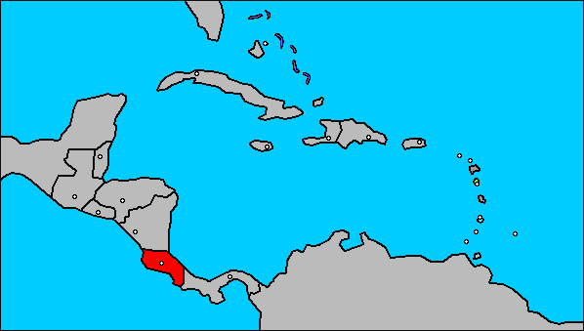

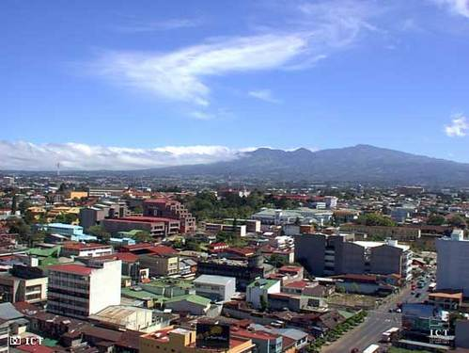
Costa Rica
Capital: San José
Nationality: costarriqueño/costarriqueña
costarricense

Slide 27
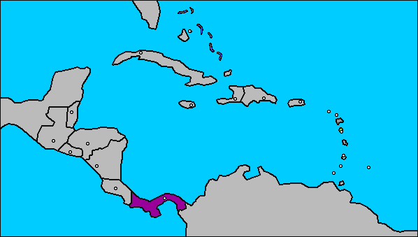

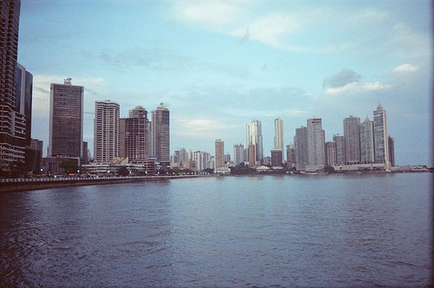
Panamá
Capital:
Cuidad de Panamá
Nationality: panameño/panameña

Slide 28
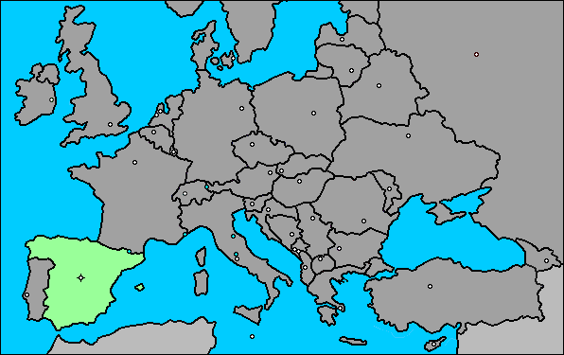

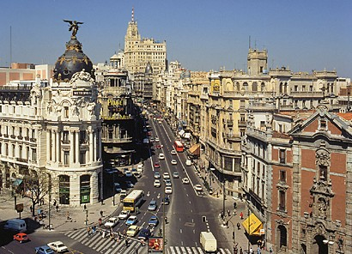
España
Capital: Madrid
Nationality:
español/española

Slide 29



España español/a
Bullfighting, considered an art and a popular attraction, is the biggest and most controversial sport in Spain
In Spain, you drive on the right hand side of the road.
Antonio Banderas
Notes:
‹#›
NOTA CULTURAL

Slide 30

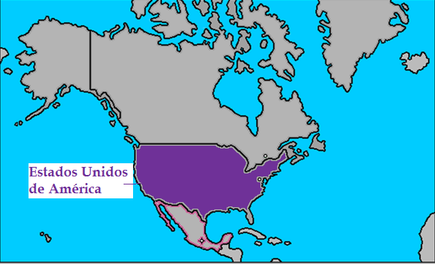
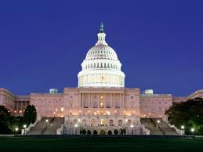
Capital: Washington, DC
Nationality:
estadounidense

Slide 31
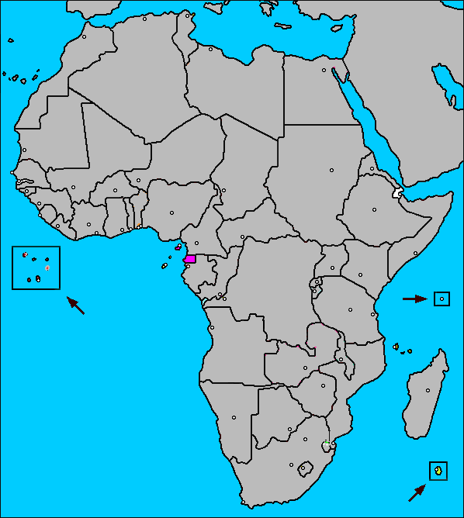

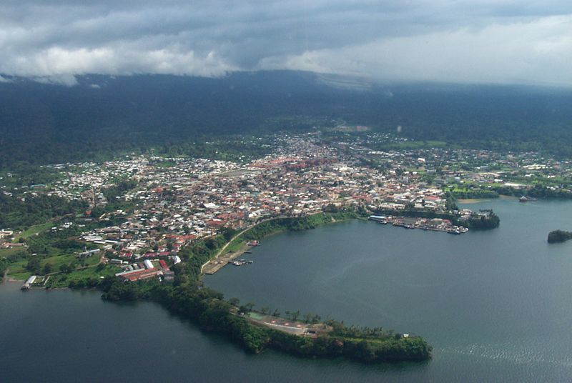
Guinea Ecuatorial
Capital: Malabo
Nationality: guineano / guineana

Slide 32


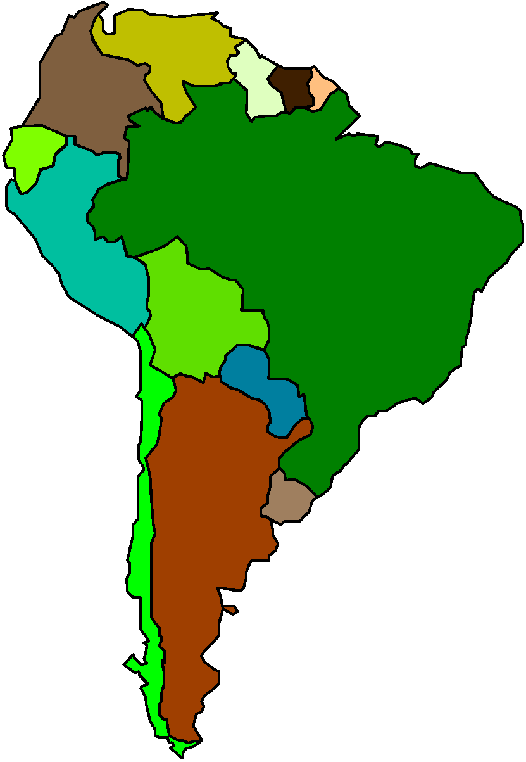

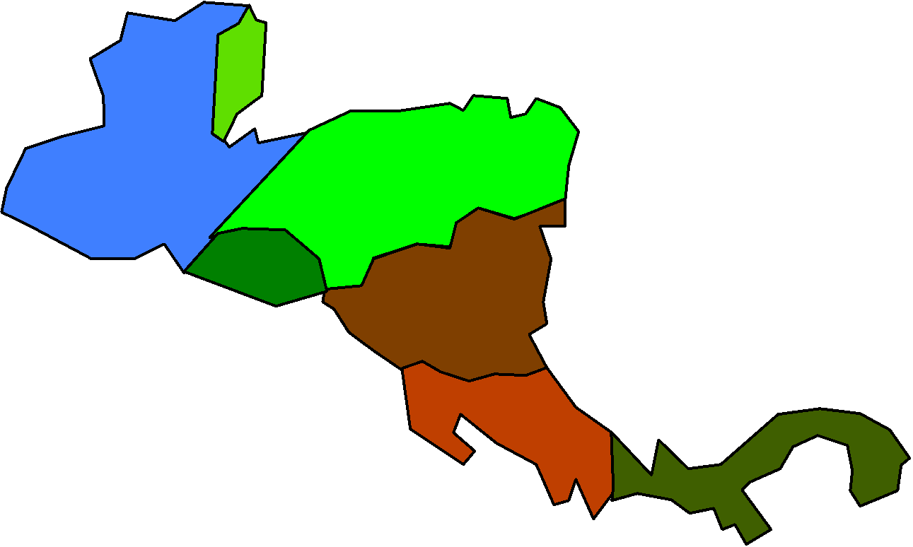
Las Antillas
Cuba
Puerto Rico
España
La República
Dominicana
México y la
América Central
La América
del Sur

Slide 33
Las Antillas
Puerto
Rico
Cuba
La República
Dominicana
España

Slide 34
Where are you from?
¿De dónde eres? - Where are you from?
Soy de Jamaica - I am from Jamaica
¿Cuál es tu nacionalidad? - What is your nationality?
Soy Jamaicana - I am Jamaican
SOY means - I am/I’m

Slide 35
Where do you live?
¿Dónde vives? - where do you live?
Yo vivo en- I live in
Yo vivo en jamaica - I live in Jamaica.

Slide 36
VAMOS A CANTAR
ES DE PANAMA ,ES DE CUBA,
ES DE HAITI, ES DE FIJI,
NO SOY DE PANAMA, NO SOY DE CUBA
SOY DE JAMAICA, SOY JAMAICANA, JAMAICANA

Slide 37
¿De Dónde eres? - ¡Hablemos!
For this activity, we will practice speaking. You will be taking on various identities.
Everyone will receive an “identity” that you will wear as you walk around the room.
As you walk around the room:
Greet another student.
Introduce yourself to them, including who you are.
When you have both introduced yourselves, exchange “identities.”
Then, go greet and introduce yourself to another student.

Slide 38
ENTREVISTA
Interview 5 of your classmates. DRAW A TABLE IN YOU NOTE BOOKS WITH COLUMN TITLED: nombre, ¿de dónde eres?, ¿ dónde vives?
1. ASK THEM THEIR NAMES
2. WHERE THEY LIVE
3. WHERE THEY ARE FROM
5. WRITE COMPLETE SENTENCES BASED ON THE INFROMATION YOU RECEIVE.
EJEMPLO:
MARIANA VIVE EN JAMAICA. ELLA ES DE JAMAICA. ELLA ES JAMAICANA

